Slide 1
Parallel algorithms for finding
Convex hullS
In 2d

Slide 2
Definition

Slide 3
APPLICATIONS
COLLISION AVOIDANCE
SMALLEST BOX
Shape analysis
source: https://brilliant.org/wiki/convex-hull/

Slide 4
PLAN OVERVIEW
12.10
Deciding on topic
16.11
Finishing at least 1 algorithm
26.11
Finishing a 2nd algorithm
03.12
Finishing a 3rd algorithm
Improving implementations, measurements, adding new features
18.12

Slide 5
Plan details
16.11
Chan’s algorithm*
Implementing sequential version
Implementing parallel version
Implementing variations of the algorithm
Running implementation on Euler
Designing benchmarks
26.11
Quickhull
03.12
Secret ;)
*A Minimalist’s Implementation of the 3-d Divide-and-Conquer Convex Hull Algorithm - Timothy M. Chan

Slide 6
Plan details
16.11
Chan’s algorithm
Implementing sequential version
Implementing parallel version
Implementing variations of the algorithm
Running implementation on Euler
Designing benchmarks
26.11
Quickhull
03.12
Secret ;)

Slide 7
Jarvis March

Slide 8
Graham Scan
5
7
3
4
6
1
8
2
ß

Slide 9
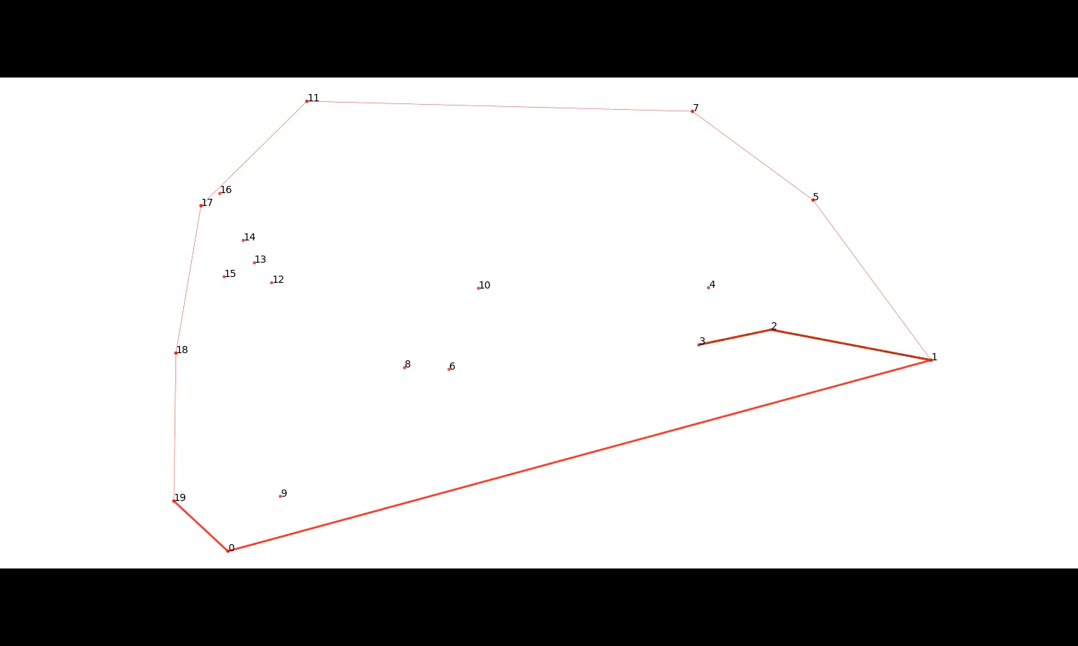

Slide 10
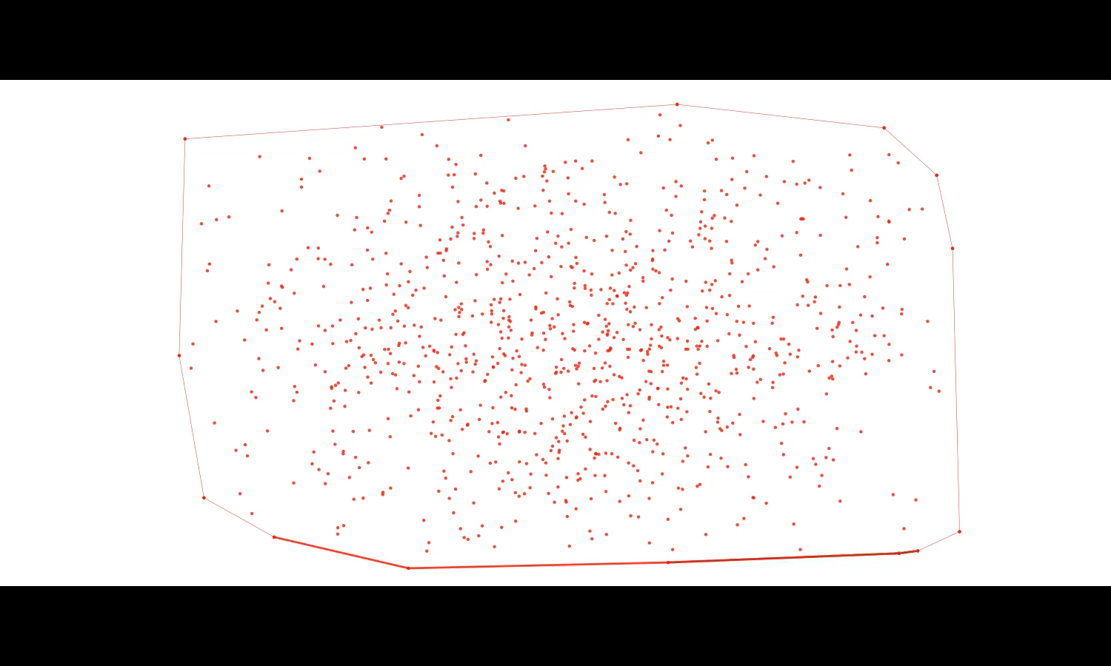

Slide 11
Chan’s algorithm
INPUT POINTS
GS
GS
GS
GS
JM
OUTPUT POINTS

Slide 12
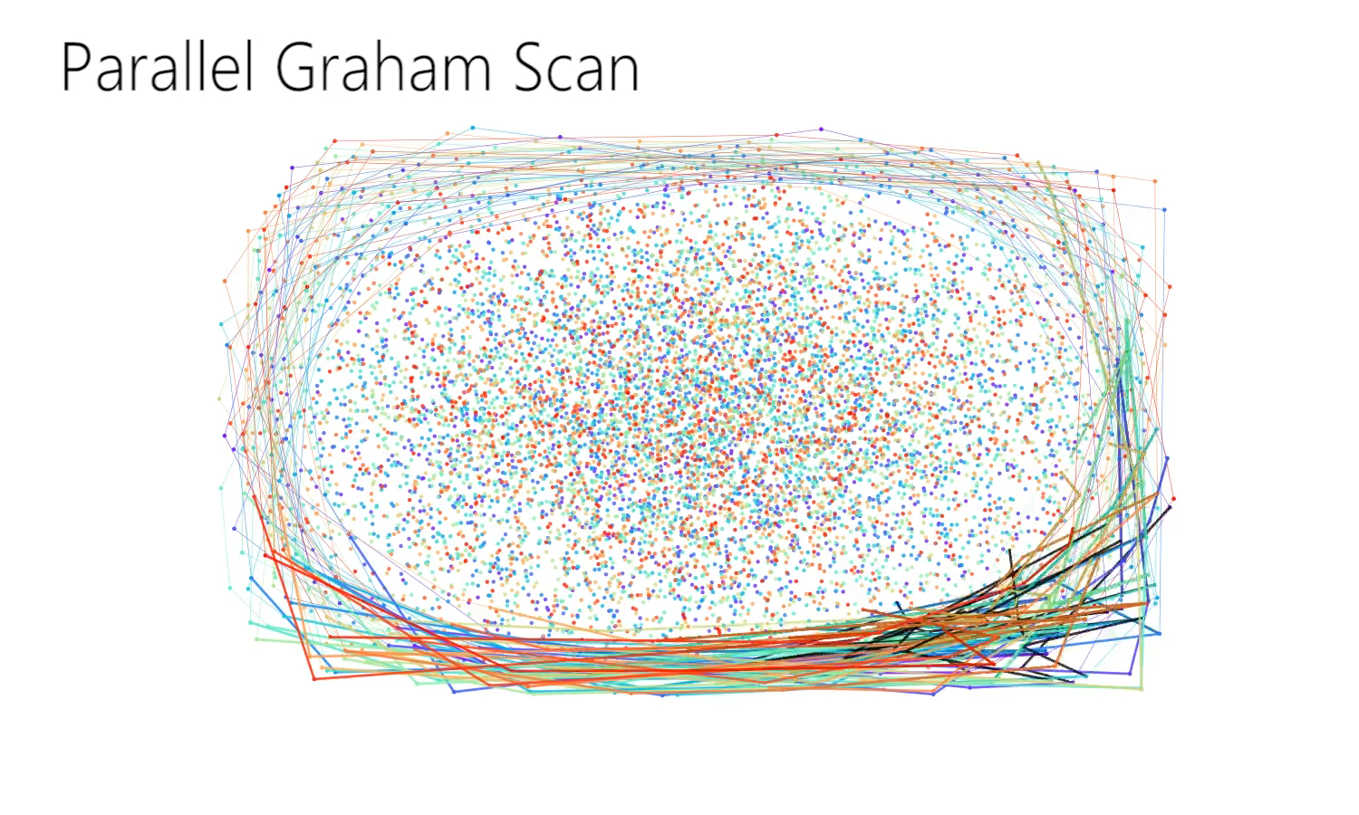

Slide 13
Plan details
16.11
Chan’s algorithm
Implementing sequential version
Implementing parallel version
Implementing variations of the algorithm
Running implementation on Euler
Designing benchmarks
26.11
Quickhull
Variations
03.12
Secret ;)

Slide 14
Chan’s algorithm
INPUT POINTS
GS
GS
GS
GS
JM
JM
JM
OUTPUT POINTS

Slide 15
QUESTIONS

